Slide 1
HCAHPS Patient Experience Analysis
Final Executive Presentation Prepared By: Neha Pandey Data Analytics Internship Submission Date: 6 August 2026

Slide 2
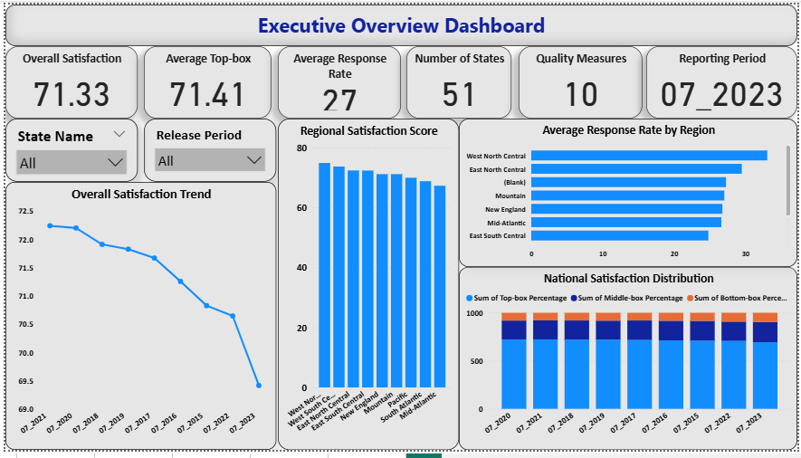
Organization Overview
About HCAHPS
The Hospital Consumer Assessment of Healthcare Providers and Systems (HCAHPS) is a standardized national survey that measures patients' perspectives on hospital care.
The survey helps healthcare organizations to:
Measure patient satisfaction.
Evaluate healthcare service quality.
Compare hospital performance.
Support data-driven decision-making.
Improve patient experience across hospitals.
HCAHPS Patient Experience Dashboard

Slide 3
Business Problem
Healthcare organizations face several challenges in monitoring and improving patient satisfaction:
Patient satisfaction varies across hospitals, states, and regions.
Large volumes of HCAHPS survey data make manual analysis difficult.
Identifying low-performing quality measures requires significant time and effort.
Hospital administrators need interactive dashboards for faster and more accurate decision-making.
Healthcare organizations require data-driven insights to improve patient experience and service quality.

Slide 4
Project Objectives
Analyze HCAHPS patient satisfaction data.
Evaluate hospital performance across states and regions.
Develop an interactive Power BI dashboard.
Identify trends and performance gaps using data analysis.
Generate actionable business insights and executive recommendations.
Support data-driven healthcare decision-making.

Slide 5
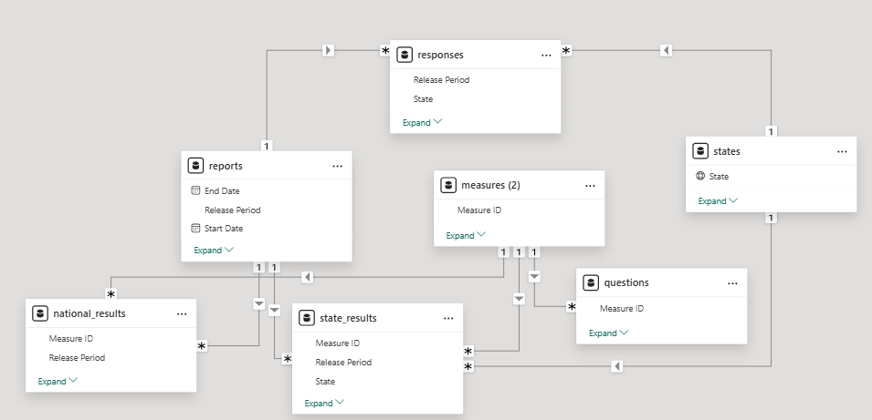
Dataset Overview & Data Model
Dataset Summary
Dataset: HCAHPS Patient Experience Survey
Purpose: Analyze patient satisfaction and hospital performance.
Data Source: CMS (Centers for Medicare & Medicaid Services)
Reporting Levels: National, Regional, and State
Reporting Period: Multiple reporting years
Analysis Tool: Microsoft Power BI
Data Tables
Measures
National Results
State Results
Responses
Reports
Questions
States
Power BI Relational Data Model (Star Schema)

Slide 6

KPI Framework
Key Performance Indicators (KPIs)
The dashboard monitors the following KPIs to evaluate patient satisfaction and healthcare quality:
Overall Satisfaction Score – Overall patient satisfaction score.
Average Top-box % – Percentage of patients giving the highest satisfaction rating.
Average Response Rate – Percentage of completed patient surveys.
Number of Participating States – Total states included in the analysis.
Number of Quality Measures – Total healthcare quality measures evaluated.
Reporting Period – Reporting period currently selected for analysis.
Executive KPI Dashboard

Slide 7
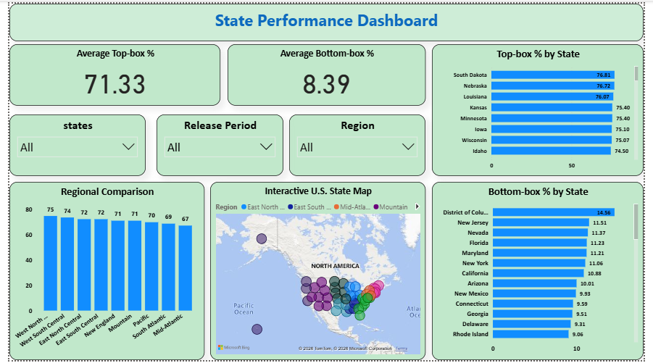
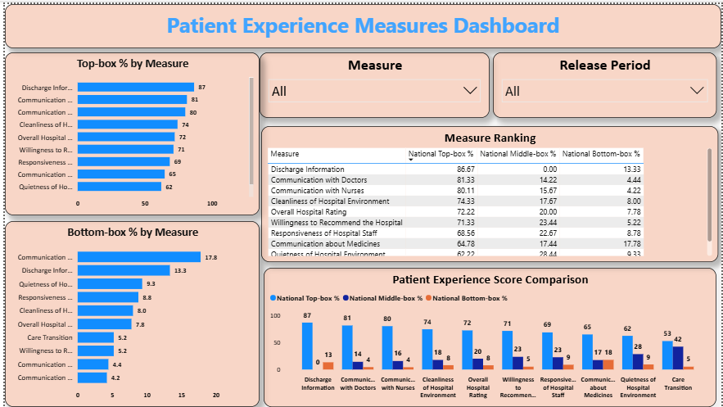
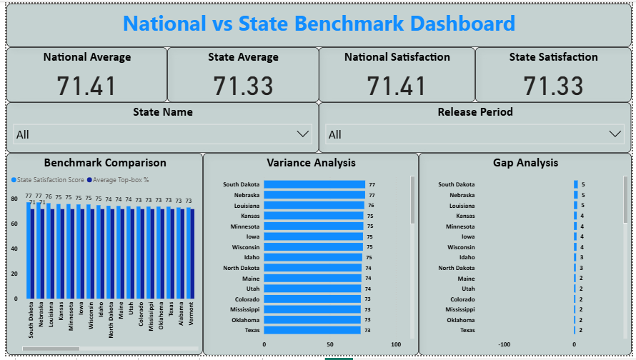
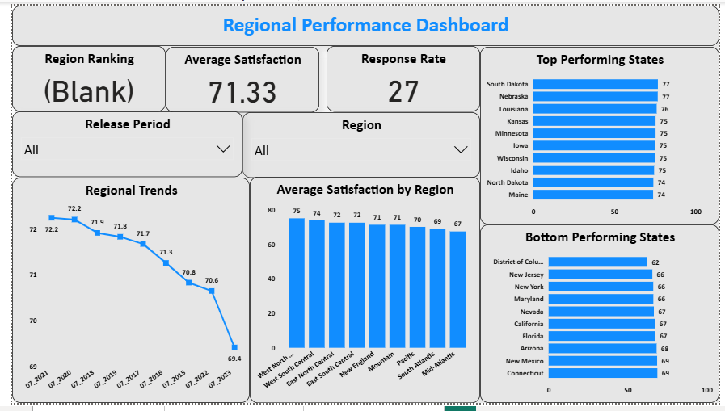
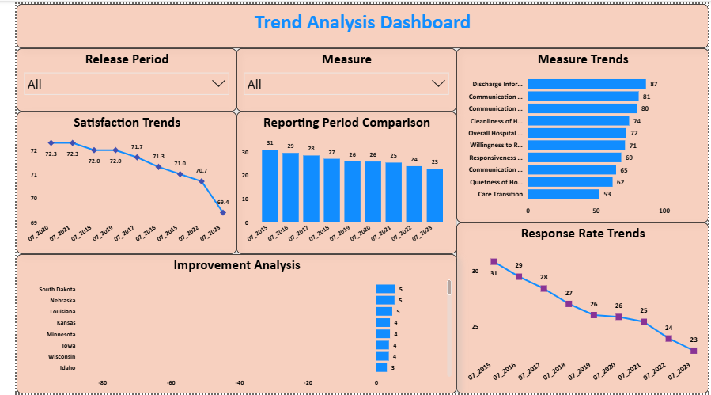
Dashboard Demonstration
Executive Overview Dashboard
State Performance Dashboard
Patient Experience Measures Dashboard
National vs State Benchmark Dashboard
Regional Performance Dashboard
Trend Analysis Dashboard

Slide 8
Key Findings
Major Findings
Communication with Doctors achieved higher patient satisfaction than Communication about Medicines.
Patient satisfaction varies across different states and regions.
Top-performing states consistently maintained higher satisfaction scores.
Response rates differed across reporting periods, affecting comparison reliability.
Interactive Power BI dashboards improved healthcare performance monitoring.
Business Impact
Better communication improves patient trust.
Regional analysis supports targeted improvements.
Dashboard insights enable faster decision-making.
Benchmarking identifies high-performing hospitals.
Data-driven reporting supports continuous quality improvement.

Slide 9
Strategic Recommendations
Immediate Recommendations
Improve communication between healthcare providers and patients.
Conduct regular staff training on patient care and communication.
Enhance patient experience through quality improvement initiatives.
Increase HCAHPS survey participation and response rates.
Long-Term Recommendations
Benchmark best-performing hospitals and regions.
Strengthen regional quality improvement programs.
Support hospital accreditation through continuous KPI monitoring.
Develop data-driven healthcare policies using dashboard insights.

Slide 10
Future Roadmap
Future Enhancements
Integrate real-time HCAHPS data for continuous monitoring.
Apply Machine Learning to predict patient satisfaction trends.
Develop AI-powered dashboards for proactive healthcare insights.
Expand the dashboard to include additional hospital quality metrics.
Enable mobile-friendly dashboards for executives and healthcare managers.
Automate report generation and KPI monitoring.
Thank You!
Questions & Discussion
Prepared by: Neha Pandey

